Slide 1

IT3160E Introduction to AI
Goal-based Agent
------- GROUP 9 -------

Slide 2

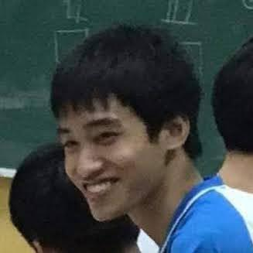




OUR TEAM
Lê Trường Giang
Trần Quốc Lập
DS-AI K64: 20194430
DS-AI K64: 20194443
Hoàng Văn Khánh
Hoàng Nguyễn Minh Nhật
DS-AI K64: 20194440
DS-AI K64: 20194445

Slide 3
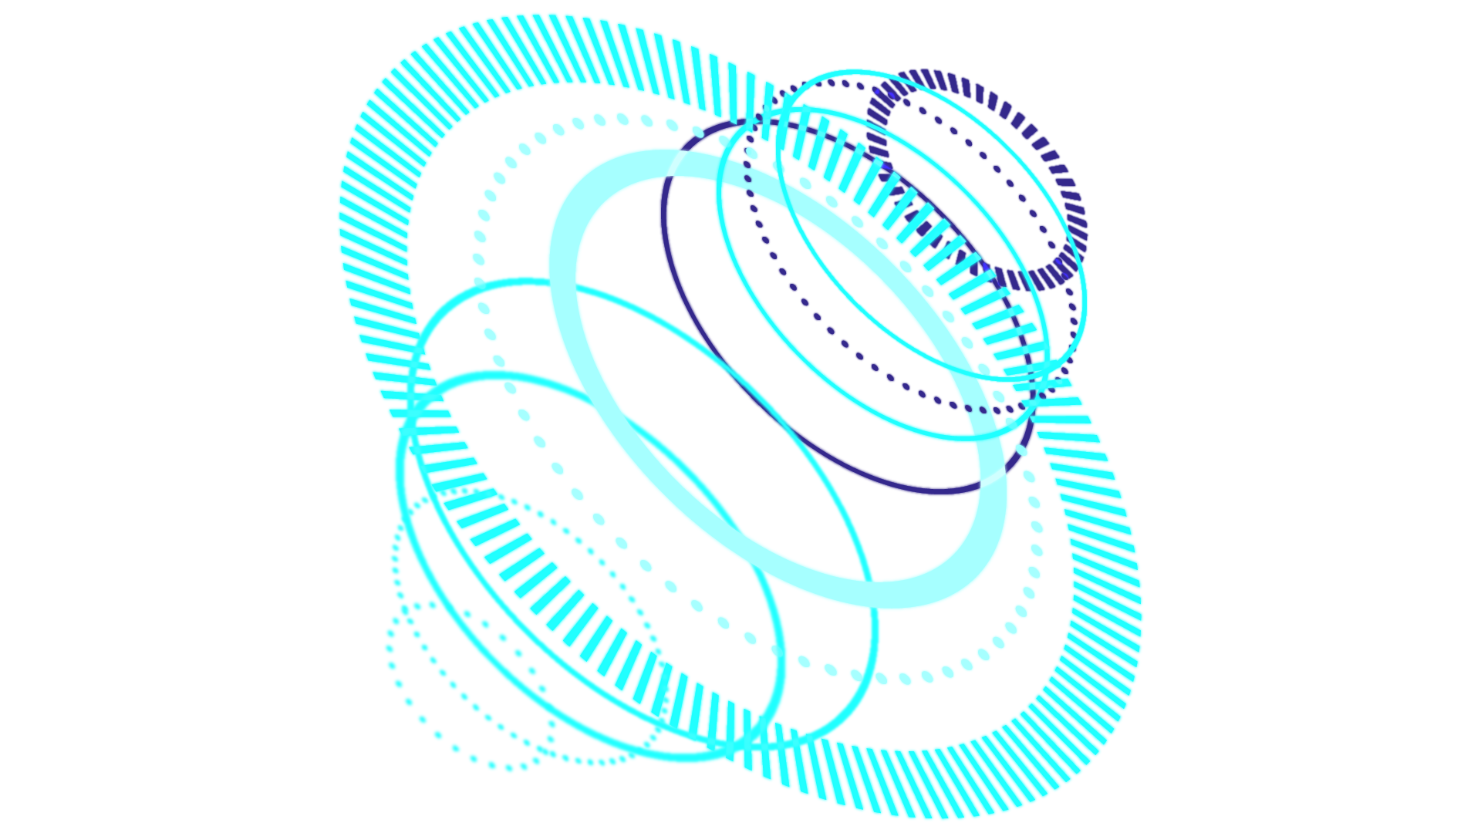
TABLE OF CONTENTS
Problem Description
01
Algorithm Implement
02
Complexity Analysis
03
+ Description
+ PEAS
+ Algorithm Description
+ Algorithm Implement
+ Experimental Data
+ Complexity Analysis

Slide 4

RICH Vacuum Cleaner
GOAL-BASED AGENT
3. Actions
Moving actions
Suck dust
Pick up
Put down
4. Solution
Action record
2. Goal
All Clean !
1. Environment
Dust – Jewel
Floor
Obstacles

Slide 5

Vacuum Cleaner Agent
INITIAL STATE
ACTIONS
GOAL TEST
PATH COST
1
Floor:
mxn board
Tile state:
board[i, j] = 0,1, 2,3,4.
Box position:
(x, y) = (0,0)
2
Turn left/right:
p(x,y) <- (x-1, y) or (x+1, y)
Move up/down:
p(x,y) <- (x, y-1) or (x, y+1)
Suck dust:
floor(m, n) -= 1
Pick up:
floor(m, n) -= 2
Put down
3
Tile state is either clean or only has obstacle:
board[i, j] = 0 or board[i, j] = 4
4
Initially state:
Path Cost = 0
Next step:
Step Cost = 1
Path Cost = sum of step costs

Slide 6

Product Demo

Slide 7


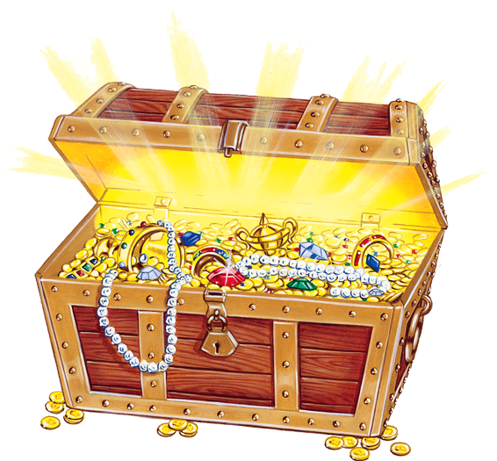
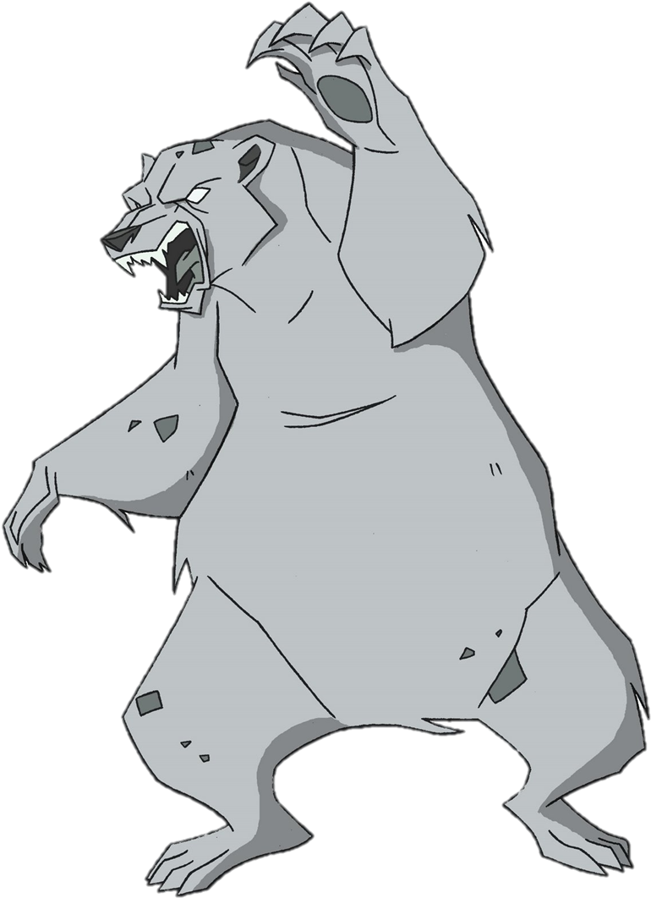
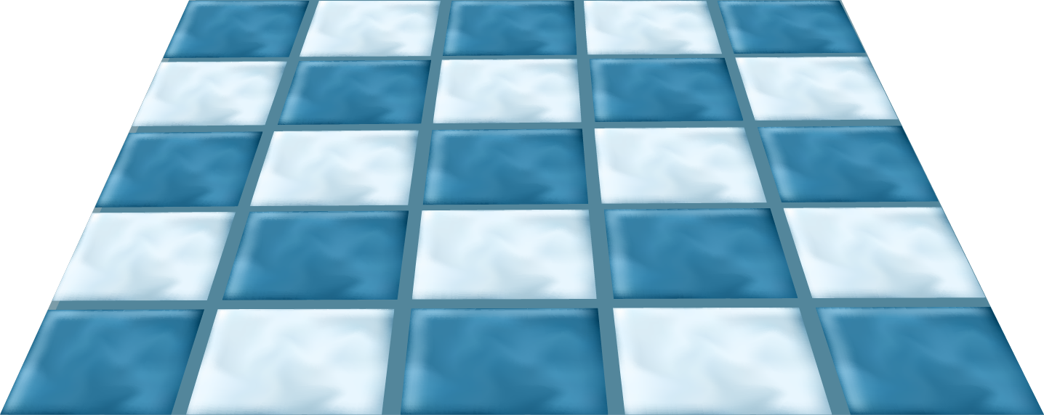
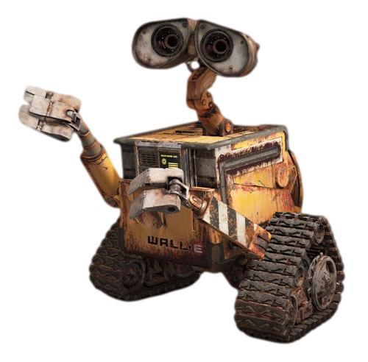

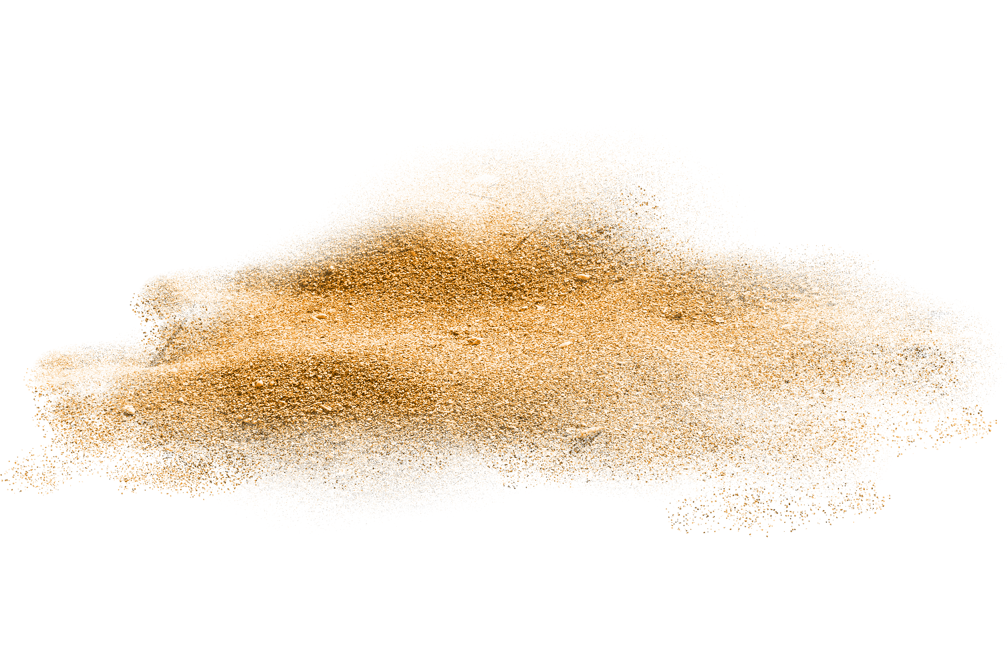
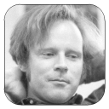
Algorithm Description
Problem Analysis
Wall-E: Which tile to move to, sir?
* For the sake of optimizing, before moving to the next tile, the vacuum should have queried environment status so as to:
skip clean tiles
skip obstacle tiles
move to the nearest tile
Floyd: Don’t worry my Wall-E, I’ll help you with that.

Slide 8
Problem Analysis
Algorithm Description
1. Board => Graph
2. Table path: Shortest path
Table matrix: Path cost
3. Updated by Floyd-Warshall
4. At each step, determine the next tile: the nearest one
5. Follow the route in path.
1
2
1 | 2
3 | 4
5 | 6
3
4
5
6

Slide 9
Problem Analysis
Algorithm Description
1. Board => Graph
2. Table path: Shortest path
Table matrix: Path cost
3. Updated by Floyd-Warshall
4. At each step, determine the next tile: the nearest one
5. Follow the route in path.
1 | 2 | 3 | 4 | 5 | 6
1 | 2 | 3 | 4 | 5 | 6
1
2
3
4
5
6
0 | 1 | 1 | 2 | 2 | 3
1 | 0 | 2 | 1 | 1 | 2
1 | 2 | 0 | 1 | 1 | 2
2 | 1 | 1 | 0 | 2 | 1
2 | 1 | 1 | 2 | 0 | 1
3 | 2 | 2 | 1 | 1 | 0
1
2
3
4
5
6
1 | 2 | 3 | 2 | 2 | 2
1 | 2 | 1 | 4 | 5 | 4
1 | 1 | 3 | 4 | 5 | 4
2 | 2 | 3 | 4 | 2 | 6
2 | 2 | 3 | 2 | 5 | 6
4 | 4 | 4 | 4 | 5 | 6
matrix
path

Slide 10
Problem Analysis
Algorithm Description
1. Board => Graph
2. Table path: Shortest path
Table matrix: Path cost
3. Updated by Floyd-Warshall
4. At each step, determine the next tile: the nearest one
5. Follow the route in path.
1 | 2 | 3 | 4 | 5 | 6
1
2
3
4
5
6
1
2
1 | 2 | 3 | 2 | 2 | 2
1 | 2 | 1 | 4 | 5 | 4
1 | 1 | 3 | 4 | 5 | 4
2 | 2 | 3 | 4 | 2 | 6
2 | 2 | 3 | 2 | 5 | 6
4 | 4 | 4 | 4 | 5 | 6
3
4
5
6
path

Slide 11
Problem Analysis
Algorithm Description
1. Board => Graph
2. Table path: Shortest path
Table matrix: Path cost
3. Updated by Floyd-Warshall
4. At each step, determine the next tile: the nearest one
5. Follow the route in path.
1 | 2 | 3 | 4 | 5 | 6
1
2
3
4
5
6
1
2
1 | 2 | 3 | 2 | 2 | 2
1 | 2 | 1 | 4 | 5 | 4
1 | 1 | 3 | 4 | 5 | 4
2 | 2 | 3 | 4 | 2 | 6
2 | 2 | 3 | 2 | 5 | 6
4 | 4 | 4 | 4 | 5 | 6
3
4
5
6
path
Floyd-Warshall: For each vertex k, minimize the path from u to v by:
matrix[u, v] = min(matrix[u, v], matrix[u, k] + matrix[k, v])
Pros: reusability, avoid obstacles | Cons: auxiliary space memory O(N²)

Slide 12
Implementing Algorithm
board, starting_tile <- Create_Data(m, n)
matrix, path <- Floyd_Warshall(board)
X <- <container for vacuum's journey, initially empty>
WHILE <the board is not clean>:
destination <- Find_Tile(starting_tile) # the nearest and less untidy (not clean yet)
route <- Shortest_Path(path, starting_tile, destination)
IF <destination has dust only>:
X.APPEND(starting_tile, destination, route, "SuckDust")
starting_point <- destination
ELSE:
X.APPEND(starting_tile, destination, route, "Pickup")
route <- Shortest_Path(path, destination, box)
X.APPEND(destination, box, "PutDown")
starting_point <- box
<PRINT X>

Slide 13

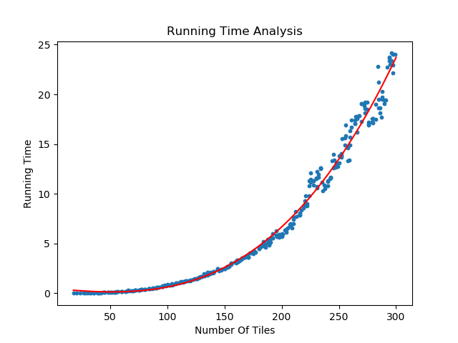
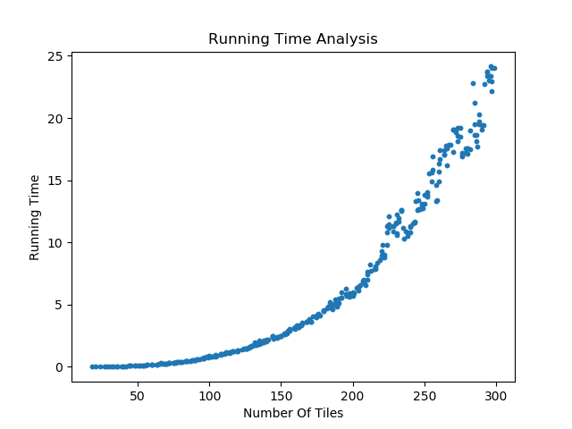

EXPERIMENTAL ANALYSIS
✔ Runtime and Cost to complete tested on 300 random data sets.
✔ Tested on: Intel® Core™ i5-7300HQ CPU @ 2.50Hz 2.50Hz
O(N³)
TIME COMPLEXITY
O(N²)
SPACE COMPLEXITY
300 DATA SETS
MIN: 4X4
MAX: 20X20

Slide 14
Thank You For Listening !

